Slide 1
Legislative Training
Notes:
Add in the Chat What types of Questions you should ask when beginning research*

Slide 2
Scheduling meetings with Legislators this January/February to ask for their support on (good MA letter [last year’s letter] and not support the AHIP letter)
Last year’s Jayapal letter: https://jayapal.house.gov/wp-content/uploads/2023/02/230216-MA-Letter-Final-with-Signatures3.pdf
Last year’s AHIP letter: https://www.ahip.org/resources/senate-bipartisan-medicare-advantage-letter

Slide 3
Small vs. Large
Business Associates
Family and Friends
How much?
Previous Employment
Donors
Decision Maker
Neighborhood
Party Reliability
Political Career
Constituents
Voting History
Margin of Victory
Previous Supporters
Communities

Slide 4
What is a Power Analysis (PowerMap)?
Information used to leverage stakeholders’ position
Tools to identify and influence people and groups in power
What types of Questions do would you want to research?
Notes:
Could be anyone, we’re focussing on Leg. and MA

Slide 5
Political History and Future
Election landscape
Recent results - Victory Spread
Opposition (in party or competing party)
Voting base
What kinds of people support them?
What neighborhoods/cities/geographic areas?

Slide 6
Donors
Small donors vs Large donors
Corporations, especially impacted companies
PNHP allies or M4All supporters
Organizational support
Political orgs
Activist groups
Other elected officials

Slide 7
Personal Life
Community - where do they live?
Religiosity
Family - What is their family status? (do they have an elder in the family)

Slide 8
Small vs. Large
Business Associates
Family and Friends
How much?
Previous Employment
Donors
Decision Maker
Neighborhood
Party Reliability
Political Career
Constituents
Voting History
Margin of Victory
Previous Supporters
Communities

Slide 9
Example Power Analysis
Stephan Ramdohr

Slide 10
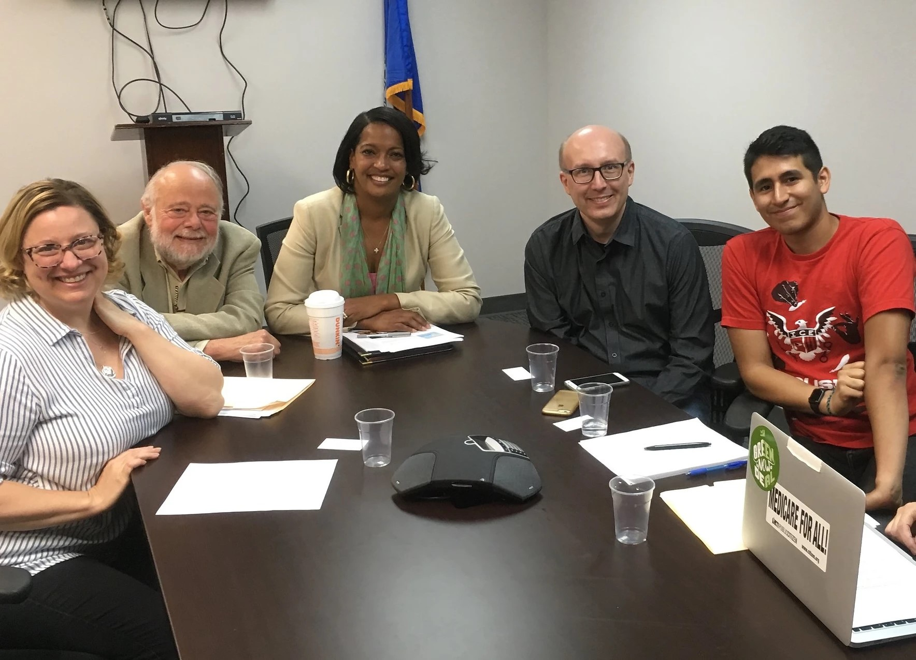
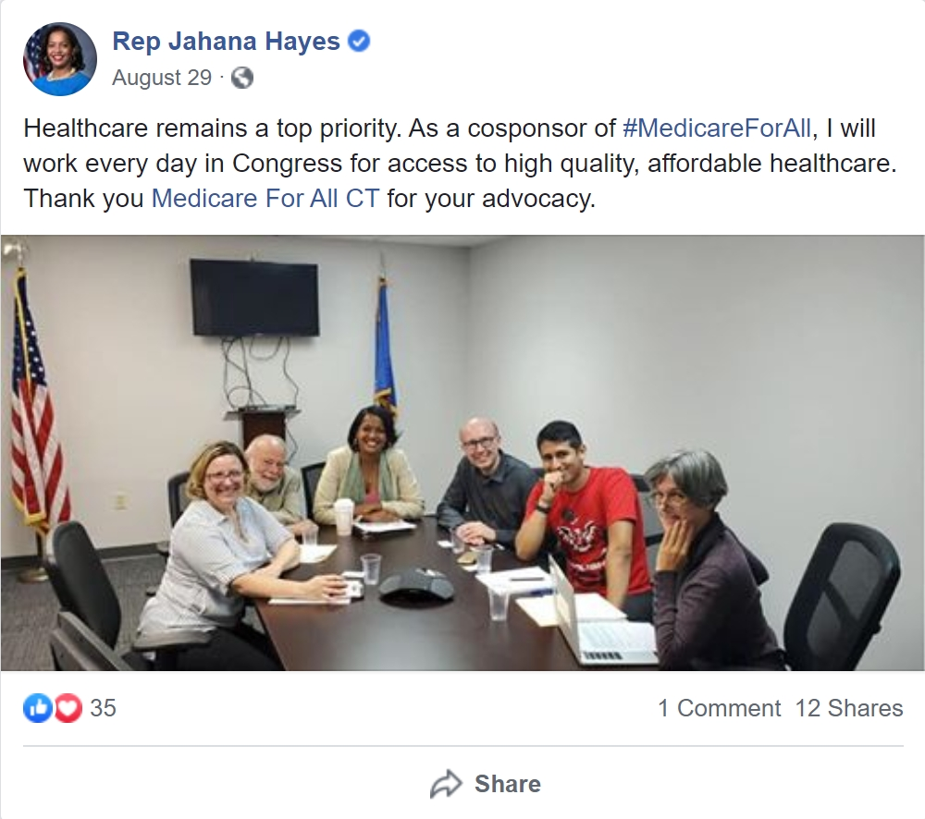
Example Legislative Outreach
Medicare for All CT repeatedly asked Jahana Hayes before and after town hall events or debates etc, to co-sponsor the Medicare for All bill once she gets elected. As a result of this, even before she won her primary, she published a Medium article about her support for Medicare for All. After the bill was introduced and she actually co-sponsored, Medicare for All CT met with her to thank her.

Slide 11
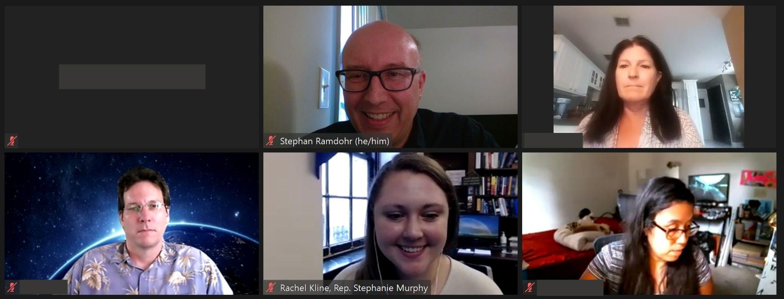
Example Legislative Outreach
Medicare for All Florida together with PDA scheduled a meeting with U.S. Rep. Stephanie Murphy’s office, to ask to co-sponsor the Medicare for All Act. It needed repeated follow-up every two weeks, so finally after months a meeting was scheduled.

Slide 12
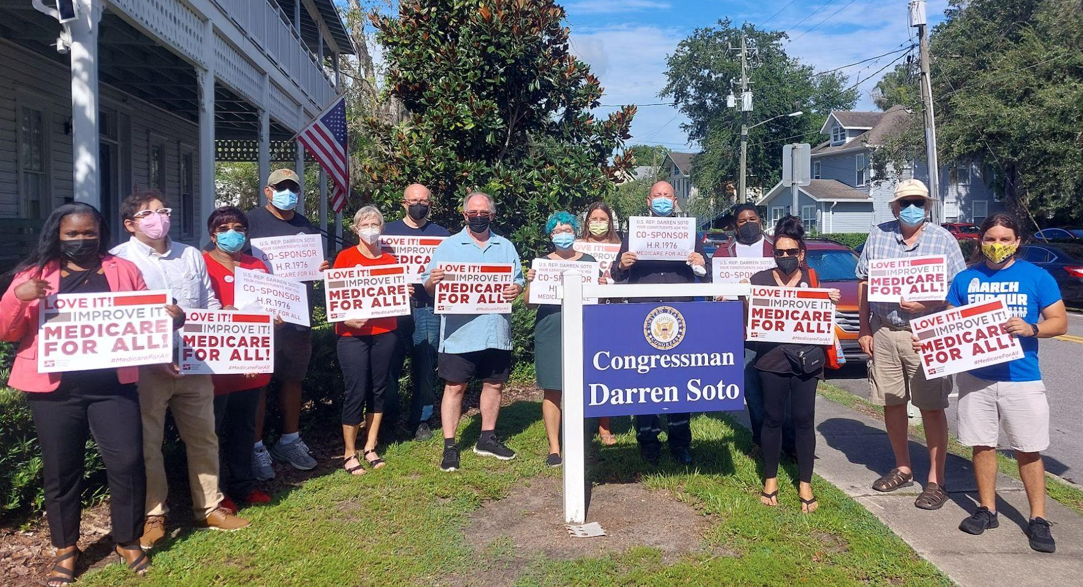
Example Legislative Outreach
Medicare for All Florida together with National Nurses United and PDA collected more than 300 signatures from constituents as well as 20+ organizational letters asking Rep. Soto to co-sponsor the Medicare for All bill. While the local TV news reported about the action etc, he did not sign on yet, so with a power analysis activists might now have an opportunity to reach out with the ask to oppose Medicare Advantage.

Slide 13
Example Power Analysis
Political
Election landscape
Recent results
Opposition (in party or competing party)
Voting base
What kinds of people support them?
What neighborhoods/cities/geographic areas
Personal
Community - where do they live?
Religious org - where do they worship?
Job - Do they have outside income?
Family - What is their family status
Donors - where is the money coming from
small donors vs large donors
Corporations, especially impacted companies
PNHP allies or M4All supporters
Total amount
Organizational support
Political orgs
Activist groups
Other elected officials
Key issues
Position on contested votes
Lead sponsorships on important bills
Issues they prioritize in communications, ads, etc
Other
Career stage
Ambitions
Peers

Slide 14
Getting the Meeting
Sharing Stories with Carol Paris and Lori Clark

Slide 15
Next Steps
HOMEWORK: Request meetings for January/February
Create a Power Analysis
Next Month’s Activist Call January 11th - Planning and Running the Meeting
Membership link: https://pnhp.org/join/

