Slide 1
Refuge Association
Quarterly Legislative Update
Libby Marking
Director of Government Affairs & Public Policy

Slide 2
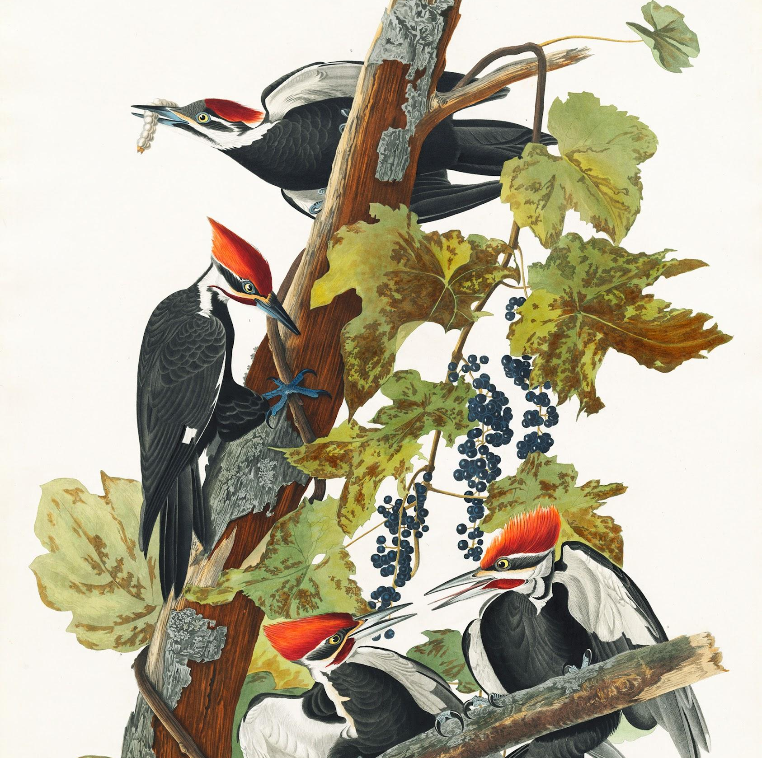
Agenda
Appropriations
Refuge Specific Issues
System Wide Issues
Staffing Challenges
How to Get Involved

Slide 3
Appropriations

Slide 4
FY23 Overview
The FY22 appropriations level is $519m, only a $16m increase since FY10
The President’s FY23 Budget Proposal includes $597m
The House FY23 Appropriations bill includes $574m
The Senate FY23 Appropriations bill includes $550m

Slide 5
The Refuge Association Requested $712m for Refuge System Operations & Maintenance
$294m
Wildlife and Habitat Management
$127m
Refuge Visitor Services
$70m
Refuge Law Enforcement
$42m
Conservation Planning
$179m
Refuge Maintenance

Slide 6
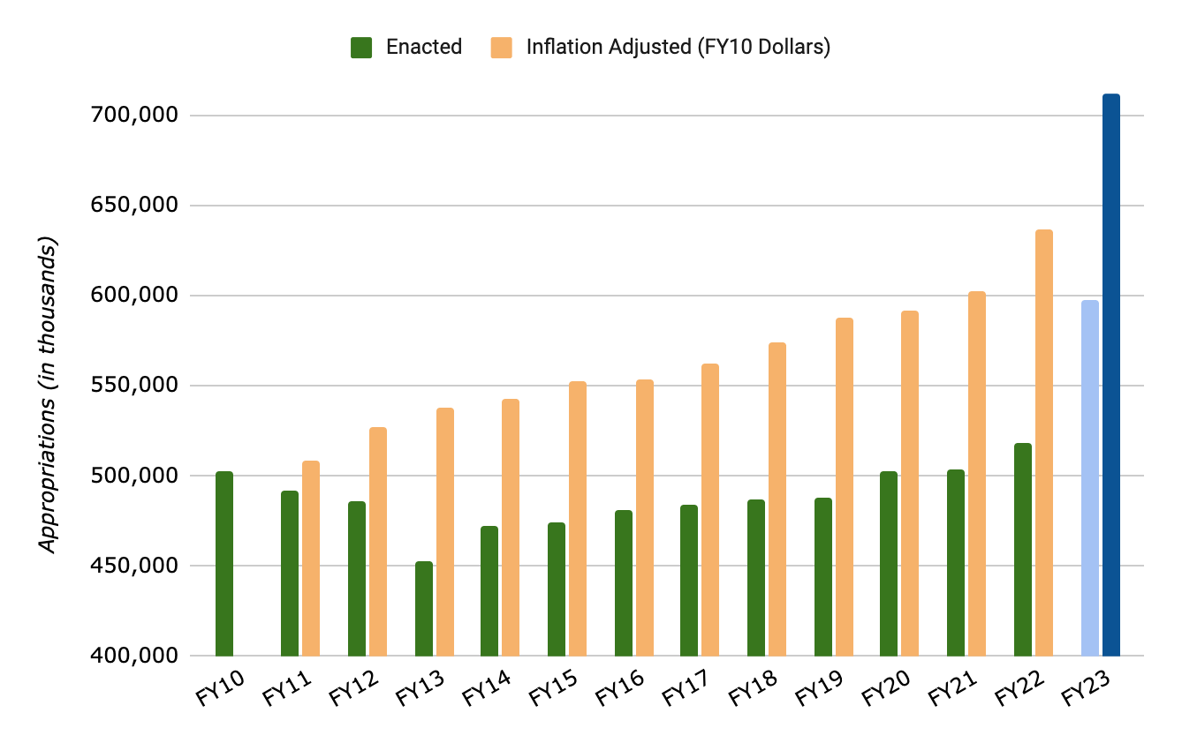
Inflation
Refuge System Operations & Maintenance Appropriations
FY 2010 - FY 2023 Appropriations vs. Consumer Price Index (CPI) Inflation
The $503 million appropriated to the Refuge System in FY2010 is worth approximately $641 million today (as of January 2022).

Slide 7
Status of FY23 and FY24 Appropriations
FY23
A Continuing Resolution (CR) will be voted on this week (and likely passed) to keep the government funded and operating until Dec. 16
Still time to weigh in on FY23!
FY24
FY24 process will officially begin after President’s Budget Request is released, typically mid-February.
The Cooperative Alliance for Refuge Enhancement is leading a large group letter to President Biden requesting increased funding
We will be advocating for a specific funding amount after more conversations with FWS and within the coalition

Slide 8
Recent Issues - Refuge Specific
Lead ammunition and tackle regulations
Supported the voluntary phase out of all lead used for hunting on Patuxent Research Refuge, Rachel Carson, Great Thicket, Erie, Wallops Island, Chincoteague, and Canaan Valley Refuges, and the phase out of all lead used for hunting and fishing on Eastern Neck, Blackwater, and Patoka River NWRs.
Supported FWS decision to not allow hunting with lead ammunition or fishing with lead tackle on any newly opened refuge lands.
Refuge Expansion
Pacific Remote Islands Marine National Monument
Izembek NWR
Arctic NWR
SunZia Southwest Transmission Project - Sevilleta NWR

Slide 9
Recent Issues - System Wide
Inflation Reduction Act
$121 million to address the threat of invasive species and increase the resiliency and capacity of habitats within the NWRS and State wildlife management areas.
Keeping America’s Refuges Operational Act (H.R.6734)
Passed House
Reauthorizes appropriations for the NWRS volunteer, educational, and community partnership programs.
National Wildlife Refuge Week Resolutions
October 9-15

Slide 10
Staffing Campaign
Lack of staff is the largest problem on refuges right now
NWRS has complexed refuges, set up strike teams, cut staffing levels to the bone- there’s nowhere else to cut
Friends can help- letters to the editor, district office meetings, invite Members to your Refuge

Slide 11
Get Involved
Sign CARE’s FY24 Letter to President Biden
National Wildlife Refuge Week - October 9-15
Lookout for toolkit from NWRA
Toolkit for outreach to your elected representatives and form to report back to NWRA on any meetings or visits

Slide 12
Other Ways to Stay Involved
Educating Members of Congress and local decision makers
https://refugeassociation.org/s/NWRA-FY23-Appropriations-Request.pdf
https://refugeassociation.org/s/Supporting-the-National-Wildlife-Refuge-System-Fact-Sheet.pdf
Participate in Action Alerts
Submit Public Comments and Hearing Testimony
Support critical legislation
Invite anyone elected in your area to the refuge
Keep in touch and keep them updated!
Op-eds and letters to the editor
Community events at the refuge

Slide 13
Stay Updated
Quarterly Friends Newsletter - The Link
CORFA Facebook Group
NWRA Legislative Updates
Sign up for Action Alerts
YouTube Channel
Social Media
Website

