Slide 1
Children's Integrated Services
Claire kendall, Family Center of Washington County
Chloe learey, Winston Prouty

Slide 2
Overview of CIS services
Unique to Vermont, Children’s Integrated Services (CIS) is a noteworthy innovation in the delivery of evidence-based, informed and integrated services to families with young children.
It is a model that requires CIS providers not simply to cooperate or collaborate, but to integrate the care they provide families.
Prior to the implementation of CIS, Vermont families found themselves burdened by multiple home visitors, multiple appointments and multiple, sometimes contradictory, plans of care. Regions did not have integrated data across the system of early childhood services to make informed decisions around priorities and funding.

Slide 3
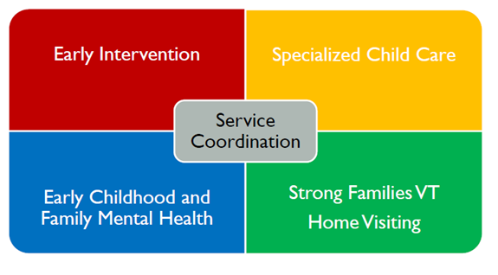
CIS offers 4 core services to families of young children facing challenges

Slide 4
CIS OVERVIEW: SYSTEM STRUCTURES
CIS State Team: Staff in Waterbury provide program oversight and support
Fiscal Agent Contractor: A single agency in each region holds the CIS contract
Regional CIS Admin Team: A coalition of providers and partners governs regional CIS system and ensures service delivery
Local CIS Coordinators: An individual in each region coordinates partners, reporting, etc.
Regional Intake & Referral Team: Weekly meetings triage referrals and collaborate

Slide 5
Overview of CIS services
The prevention and early intervention services that compose CIS have immediate and long-term benefits. CIS focuses on whole families and support’s children’s social, emotional and cognitive development; family preservation, stability and unification; and supports parents’ contribution to Vermont’s workforce.
CIS services enhance and improve outcomes of complementary services such as DCF Family and Economic Services.
In an era of concern over the per-student costs of K-12 education, CIS supports children before they reach the school system, providing effective interventions for developmental issues that are more costly to address as children grow

Slide 6
VALUE AND PURPOSE OF THE CIS MODEL
The upstream services provided by the CIS system utilize a multi-generational approach for maximum impact
Research demonstrates that quality interventions and supports for children ages 0-5 have among the highest return on investment across human services- 13% ROI for high-quality birth-5 programs
CIS uses multiple evidence-based practices with proven effectiveness in impacting outcomes in health, child maltreatment prevention, education, and economic well-being
Services help to mitigate ACES and intergenerational trauma

Slide 7
Why is integration important
Ease of service access for families
Ease of referral for other providers such as pediatrics who most frequently interface with all young children and families
Integrated plans of care that reduce duplication and contradictory services for families
Availability of regional data across the system of care
Integrated funding for direct services
Regional decision making on funding priorities and allocations

Slide 8
CIS FUNDING: BUNDLED RATE METHODOLOGY
Prior to payment reform, each regional CIS contract total was based on historical spending among services providers
Regional case rates were determined by contract total and a set monthly client count and monthly case rates range from $498 to $854, with a mean of $676 across the regions
CIS bundled payment methodology was designed to allow regional Admin teams allocate funding between services based on locally-determined methodology, community need, and provider capacity
Reimbursement for bundled services from the State may not exceed contract total

Slide 9
CIS Funding challenges
In 2021 CIS received its first increase in funding since it started in 2009. However, the demand and actual costs to the 12 regional non-profit agencies that provide services have steadily increased.
There is a critical lack of capacity to serve children and families that struggle with multiple risk factors including increased child welfare involvement, exposure to parental opiate use, poverty, homelessness, and autism prevalence.
CIS also lacks a common data system, meaning both state agencies and providers lack the ability to compare outcomes, track client progress, identify improvements and efficiencies, and make real-time changes to their service plans as needed.

Slide 11
2018 Payment reform & 2021Case Rate increase
In 2018 the Child Development Division (CDD) of the Department for Children and Families paid consultants to study CIS reimbursement rates and make recommendations.
The study revealed that the rate being offered under the current contract, $512 Per Client per Month , did not cover the cost of providing services which is $634 per client per month.
In 2020 Payment reform was initiated, resulting in consistent rates across the state at $517. Some regions experienced a loss, while some were increased depending on the previous regional allocation.
In 2021 CIS received its first increase in funding since it started in 2009, bringing the statewide case rate to $600 per month.

Slide 12
The ask
A statewide CIS budget increase in the amount of $1.8 million, an investment which would meet the cost of care and ensure continued progress on family safety and stability, healthy child development, and young children’s access to quality early childhood education.
Encourage legislators to support this funding increase in the FY23 budget for Children’s Integrated Services.
Reach out to legislators to emphasize the importance of a comprehensive, continuous, and integrated system of services that serves our early childhood communities effectively.
A one-time investment of federal pandemic relief funds of $1.6 million is needed to build a statewide CIS data reporting platform.

Slide 13
What’s next
The Governor’s Recommended FY23 Budget includes level funding for CIS compared to FY22. Advocates are pressing for additional funding and have succeeded in securing the support of the House Human Services Committee.
The Committee is recommending an increase in the case rate from $600/month to $650/month in their letter to House Appropriations.
This increase would mean an additional $880,000 in annual funding for the program – still short of actual cost of care, but a badly needed increase.
Advocacy also continues in support of the request for $1.6m in one-time funds for the development of a system-wide CIS data system.
Both the House Human Services and Energy & Technology Committees are supporting this request in their budget letters to House Appropriations.
Thank House Human Services and Energy & Technology Committee members for their support.
Talking to your reps: What is your local CIS story?

