Slide 1
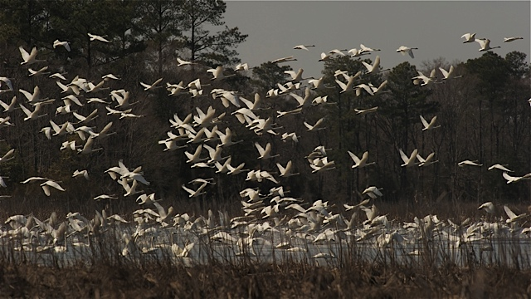
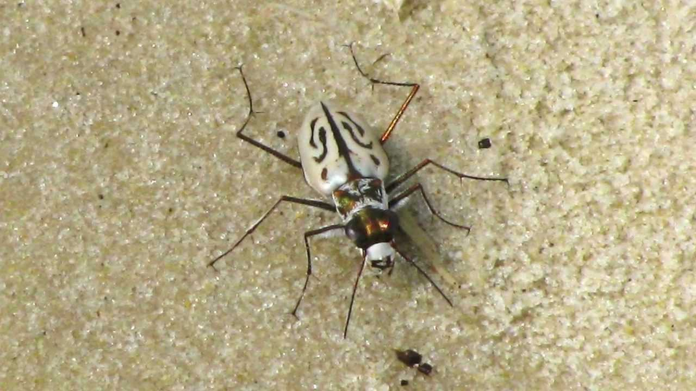
Realty 101 – The Role of Friends in Refuge Land Protection
L. Elliot

Slide 2
Agenda
Intro
The Basics
Strategic Growth and TRACT (Prioritization)
Issues raised in advance
Funding
National Initiatives
Can Friends acquire lands?
Do you wonder how Friends can influence funding decisions for land acquisition?
More questions? Put Q’s in chat.

Slide 3
Introduction
Land Acknowledgement – Nipmuc/Pocumtuc/Abenaki tribes
Caveats – Focus on Refuges (Refuge System includes lands, waters, and interests therein administered by the Service as wildlife refuges, wildlife ranges, wildlife management areas, game preserves, and conservation areas). The 146.6 million acres includes more than 54 million acres of submerged lands and waters in refuges within marine national monuments.
Will not discuss Waterfowl Production Areas (WPAs) are Refuge System lands comprised of small natural wetlands and grasslands that provide breeding, resting, and nesting habitat for millions of waterfowl, shorebirds, grassland birds, and other wildlife. Approximately 95 percent of WPA lands are located within the Prairie Pothole Region states of Iowa, Minnesota, Montana, North Dakota, and South Dakota. WPA lands are grouped by county and administered by one of the Service’s 38 wetland management districts.
Coordination Areas are Refuge System lands managed by states under cooperative agreements between the Service and state fish and wildlife agencies.

Slide 4
The Basics
Service Policy is to acquire the minimum interest in land necessary to meet refuge objectives from willing sellers
What are interests in land? Bundle of sticks (box of rocks!)
Easement vs Fee
Refuge Boundary (Director Authority, NEPA)
Who’s who?
Realty Chief (HQ), Regional Realty Officers and staff (surveyors, cartographers, realty assistants, paralegals, realty specialists), Refuge Manager
Strategic Growth of the NWRS (2014)
New refuges
Expanded refuges
Prioritization tool

Slide 6
Strategic Growth Policy (602 FW 5) Priority Conservation Features
Recovery of threatened and endangered species
We may acquire interests in lands and waters where FWS land acquisition is prescribed in threatened or endangered species recovery plans.
Conserving migratory birds of conservation concern
We may acquire interests in lands and waters to conserve groups of migratory birds that are of conservation concern if any of the following plans identify the acquisition as contributing toward achieving population objectives: PIF NA Landbird CP, U.S. Shorebird CP, NA Waterbird CP, and associated step-down management plans.
Implementing the North American Waterfowl Management Plan
We may acquire interests in lands and waters that will contribute toward achieving the waterfowl population objectives that the North American Waterfowl Management Plan and associated Joint Venture step-down management plans have identified.

Slide 7
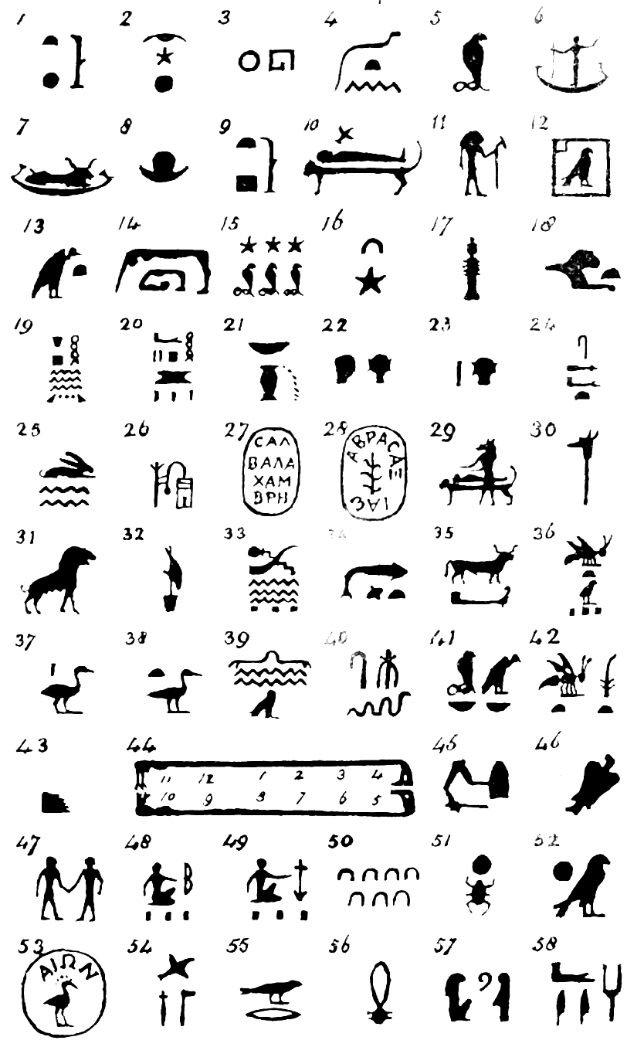
TRACT
Targeted
Resource
Acquisition
Comparison
Tool

Slide 8
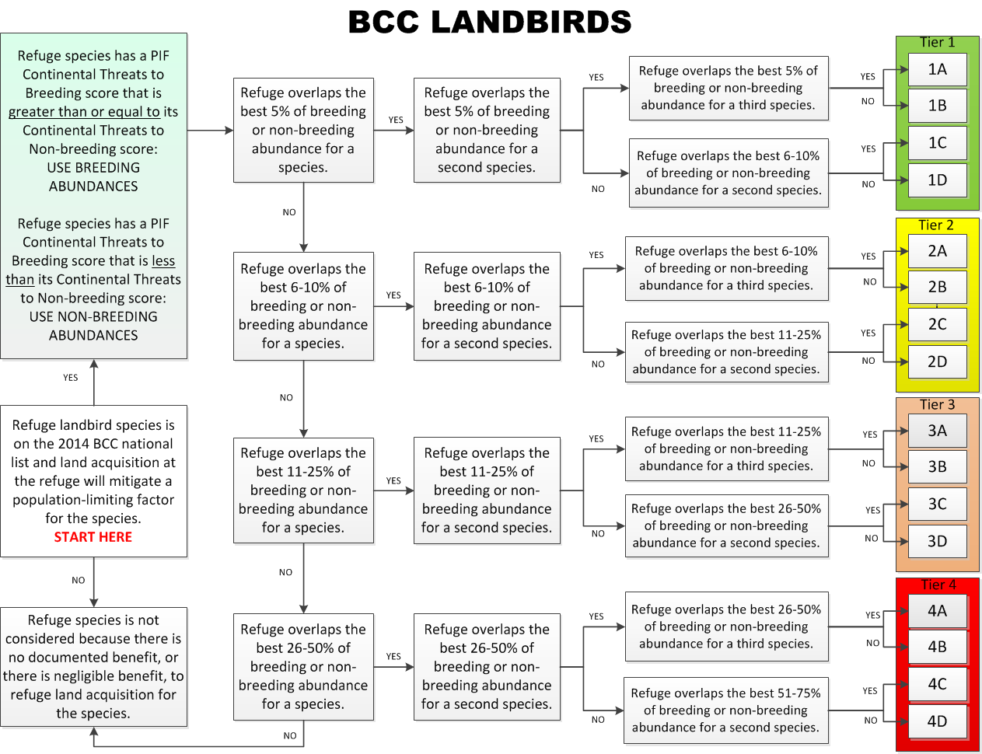
Notes:
There are two types of recovery criteria. Downlisting recovery criteria, also known as reclassification recovery criteria, are criteria that must be met to change a species status from endangered to threatened. De-listing recovery criteria are criteria that must be met to remove the species from the endangered species list. For example, a downlisting recovery criterion for an endangered species might be to protect 5 to 7 populations of at least 100 individuals that are naturally reproducing, stable or increasing in number, and secure from threats. A de-listing recovery criterion for the same endangered species might be to protect 8 to 10 populations with the same characteristics, rather than 5 to 7.

Slide 9
Questions already posed
Funding for refuge land acquisition
Land and Water Conservation Fund
Great American Outdoors Act 2020
Refuge LWCF Appropriations – $101.8m in FY22 (Projects: $57.8M, Rec access: 15.5, IEH: 10, Exchanges: 1, Acq. Mgmt: 17, Planning: 0.46)
Migratory Bird Conservation Fund
John Boozman, Sen. from AR, Martin Heinrich, Sen. from NM, Robert Wittman, Rep. from VA, Mike Thompson, Rep. from California, DOI, USDA, EPA
$40m (duck stamps) + $30m (import duties) + more = over $80m annually!
30x30 America the Beautiful
Do you know how land acquisition priorities are determined for USFWS?
Can Friends acquire lands?
Do you wonder how Friends can influence funding decisions for land acquisition?
More questions?

Slide 10
Thank you for all you do for the National Wildlife Refuge System!
joemccauley1955@gmail.com

