Slide 1
Keeping the Community in HCBS Funded Services:
Understanding and Commenting on the Statewide Transition Plan

Slide 2
Welcome
Todays Speakers
Meg Cooch, Arc of Illinois
Mariel Hamer, ICDD
Nicole Jorwic, Arc of the US
Kim Mercer-Schleider, ICDD
Leanne Mull, Blue Tower Solutions, Inc.
Carl Nave, Self Advocate

Slide 3
What We Will Talk About Today
The HCBS Settings Final Rule Refresher
What is Happening with HCBS at the Federal Level
Main Points of the Illinois Transition Plan
Making Your Voice Heard
Questions
This Photo by Unknown Author is licensed under CC BY

Slide 4
The Home and Community Based
Settings Final Rule
Notes:
Over arching information about the rule. Centers for Medicaid and Medicare. The Federal Government Created the Final rule to clarify what they consider home and community-based services. An institution is a mindset not a place. .

Slide 5
The Final Rule in Illinois
Rules apply to
Provider Owned
or
Controlled Settings
This Photo by Unknown Author is licensed under CC BY
Notes:
The rule basics when it started, the first thing, conflict free case management person centered planning required in 2014 implemented in Illinois 2016. Original implementation for the rest of the rule March 17, 2019. Please keep in mind that everything we are talking a bout should be in place right now. Currently four states do not have approved transition plans. Illinois is one. The great news is you can make many of these changes right now in residential and day program,.

Slide 6
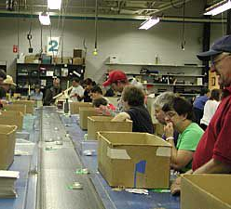
In Illinois this includes:
CILA
Day Services
Workshop
This Photo by Unknown Author is licensed under CC BY-NC

Slide 7
Person Centered Planning
Must contain the person’s hopes, dreams and INPUT!
Not a once and done
Must be in a format that the person can understand
This Photo by Unknown Author is licensed under CC BY-SA-NC
Notes:
Person centered planning

Slide 8
The Basics
The Rule defines the qualities of a home and community-based setting.
The Rule defines settings that are NOT community-based.
The Rule defines integration in the greater community AND supports full access of people receiving Medicaid HCBS to the greater community.
The setting is selected from options that include non-disability specific settings
This Photo by Unknown Author is licensed under CC BY-NC-ND
Notes:
Drill down on the rule
About Funding- does not include ICF/DD’s because they do not receive HCBS funding

Slide 9
Settings must also promote:
Individual initiative
(People deciding what they want for themselves)
Autonomy (Being as independent as you want)
Choices (Deciding what you want)
This Photo by Unknown Author is licensed under CC BY-SA-NC

Slide 10
A Lease
Notes:
Everyone in residential will have a lease. Tavarus- talk about what is included in your lease. Leanne talk about what should be included in leases for people in Cila- Decorations, house rules etc. If it is not in your lease where you live it should not be in theirs.
Talk about house rules
No eating other than kitchen
Pop machine in the dining room
Bedtimes

Slide 11
Privacy
Notes:
Right to privacy

Slide 12
Keys to room/home
Notes:
keys

Slide 13
Some Choices include…
Who to Live With (Housemate)
Where to Live
Your Own Room
This Photo by Unknown Author is licensed under CC BY-ND
Notes:
Choice of roommate Isc is required to ask where someone wants to live and honor that request
Satisfied
Own room or roommate

Slide 14
Decorating
This Photo by Unknown Author is licensed under CC BY
This Photo by Unknown Author is licensed under CC BY-ND
Notes:
Decorating who decorates your room? Your house?

Slide 15
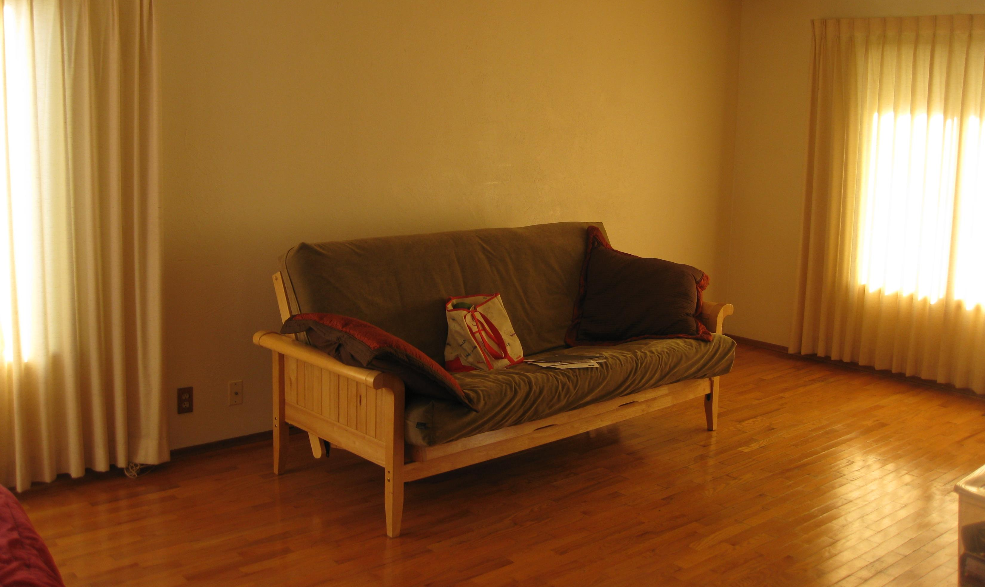
Decorating

Slide 16
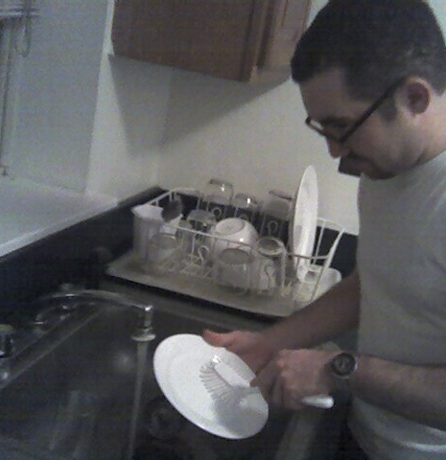
Control of schedule and activities

Slide 17
Control of schedule and activities
This Photo by Unknown Author is licensed under CC BY
This Photo by Unknown Author is licensed under CC BY-NC-ND
Notes:
Control schedule and activities

Slide 18
Access to Food at ANY TIME
This Photo by Unknown Author is licensed under CC BY-SA
This Photo by Unknown Author is licensed under CC BY-SA
This Photo by Unknown Author is licensed under CC BY-SA-NC
This Photo by Unknown Author is licensed under CC BY-NC-ND
Notes:
Access to food at any time

Slide 19
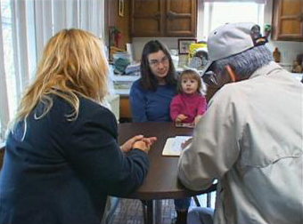
Visitors At Any Time
This Photo by Unknown Author is licensed under CC BY-SA-NC
Notes:
Visitors at any time

Slide 20
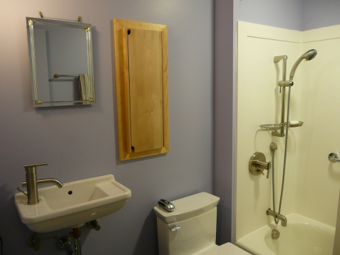
Home is Physically Accessible
This Photo by Unknown Author is licensed under CC BY-SA
This Photo by Unknown Author is licensed under CC BY-NC-ND
Notes:
Home is physically accessible

Slide 21
Temporary Restrictions
The restriction must be based on a specific need
The organization must show that positive interventions have been tried but haven’t worked, (it must be documented)
Restrictions must be revisited regularly to show the restriction is effective.
The organization must show that any restriction is TEMPORARY
Informed consent is required from the person whose rights are being restricted
The intervention must be shown to cause no harm
Notes:
Temporary restrictions

Slide 22
Day Services
Many of the same requirements apply to day services and CILA
Day Services must include regular meaningful non-work activities in integrated community settings
People must be given information about and offered the choice to do different activities including competitive work, shopping, religious services, medical appointments, dining out, etc.
People should be able to set their work schedule, break/lunch times, vacation and sick time
This Photo by Unknown Author is licensed under CC BY-SA

Slide 23
The HCBS
Final Rule
What is Happening at the Federal Level

Slide 24
Goal and Scope of the Rule
To “ensure that individuals receiving services through HCBS programs have full access to the benefits of community living”
To “further expand the opportunities for meaningful community integration in support of the goals of the ADA and the Supreme Court decision in Olmstead”
Applies to all HCBS authorities (1915(c), 1915(i), 1915(k)) as well as 1115 demo’s and 1915(b)(3) managed care

Slide 25
So what does this all mean??

Slide 26
Appropriate Timing for Capacity-Building, Transitions
Assume that some people may want/need to change settings
Due process protections
Enough time for transition
Build capacity – especially non-disability-specific settings
Waiting until the end of five-year process = recipe for bad placements, bad experiences
States not planning for provider changes/closures
Notes:
Message must come from the top, this is an opportunity for systems change.
Opportunity to build infrastructure and services.
Stakeholder input is key, public comment period for every phase of transition planning.
Requires collaboration with state Medicaid agency, state DD agency and Governor’s office.

Slide 27
State Transition Plans: Early Trends
Plans to plan v. full initial plan
Systemic review v. minimum compliance
Ongoing compliance: how do you measure?
Reliance on biased results
Participant v. provider focus
Stakeholder involvement

Slide 28
Ongoing Issues
Assessments
Integration standards
Update of state regulations and policies
Transparency
Public education and involvement
Capacity building
This Photo by Unknown Author is licensed under CC BY-NC

Slide 29
Promising Practices
Some states are proposing to modernize day services through the HCBS transition process:
Transforming models for facility-based day services (to a hub-and-spoke model) Phasing out sheltered workshops
Expanding the capacity of competitive, integrated employment
Funding help bring providers into compliance through model changes
Some states have identified day programs such as sheltered workshops and day habilitation as “settings that isolate”
CMS has said the fact that someone chose a setting does not itself make the setting compliant with the rules

Slide 30
Promising Practices
Tiered Standards:
a state may establish that certain settings currently in use in a home and community-based services waiver may continue within the waiver, as long as they will be able to meet the minimum standard set in the rule on or before the end of the transition period, but the state may suspend admission to the setting or suspend new provider approval or authorizations for those settings. Simultaneously, the state may establish or promote new or existing models of service that more fully meet the state’s standards for home and community-based services. This arrangement, though established through the transition plan, may continue beyond the transition period.”
Must be in the transition plan
Settings that meet the federal standard can remain in the waiver
New settings must meet higher state standard for particular waiver
Can continue beyond 2019
Notes:
States have flexibility to set different standards for existing and new settings through their statewide transition plan
Existing settings must meet the minimum standards set forth in the HCBS rules but the state “may suspend admission to the setting or suspend new provider approval/authorizations for those settings”
State may set standards for “models of service that more fully meet the state’s standards” for HCBS → a “tiered standard so that only those [settings] meeting the optimal standards established by the state will be developed in the future”
The tiered standard can extend beyond the transition plan timeframe
This allows states to “close the front door” to settings/services

Slide 31
Trends in State Transition Plans
Some states are using the HCBS regs as a real opportunity to modernize services to support full integration
Including phasing out sheltered workshops, setting size limits on residential settings, and expanding capacity of non-disability specific settings
Varied approach to presumptively institutional settings, especially “settings that isolate”
Some states are being rigorous in identifying settings that are presumed institutional (such as settings on the grounds of institutions, campuses, and sheltered workshops)
Other states are only identifying settings on the grounds of/adjacent to public institutions and have said they will seek to continue funding these settings

Slide 32
For initial approval:
States that include methods to validate their systemic assessments included in the plan
Included outcomes of the assessment and any needed remediation strategies (legislative changes, contract changes and changes to regulations)
Appropriate 30 day comment period and inclusion of a summary and response to comments collected.

Slide 33
For full approval:
·A comprehensive site-specific assessment of EVERY HCBS setting, including necessary strategies for validating results.
·Draft remediation strategies with a timeline for the remediation strategies that align with the end of the HCBS transition period (Marcy 17, 2019).
·Site specific remediation strategies
·Identifying a heightened scrutiny process for settings that are identified as presumed to be institutional.

Slide 34
For full approval continued
·Identify a process for communicating with beneficiaries who may be impacted by changes, closures, etc.
·Establish ongoing monitoring and quality assurance processes.
Process to evaluate privately-owned homes, can’t assume they don’t have characteristics that isolate.
·Plans to ensure that there is adequate capacity in the state for non-disability specific settings
·No reliance on reverse integration for non-residential services

Slide 35
What Does Illinois Need to Hear From Me?
Making Formal Comments to Illinois
Statewide Transition Plan (STP)

Slide 36
Things to Consider…
Your comments can be personal about the vision you have for IL
Your comments DO NOT have to be policy specific
Your comments can be VERY policy specific
BOTTOM LINE: Your comments just need to include what YOU think the State needs to hear as they continue on the quest towards compliance with the HCBS settings rule

Slide 37
Comments From a Personal Perspective: Tell YOUR Story!

Slide 38
What is my vision for services?
The Rule is designed to make sure that the services you receive provide the opportunity for integration and access to the community, choice, individual rights, and independence.

Slide 39
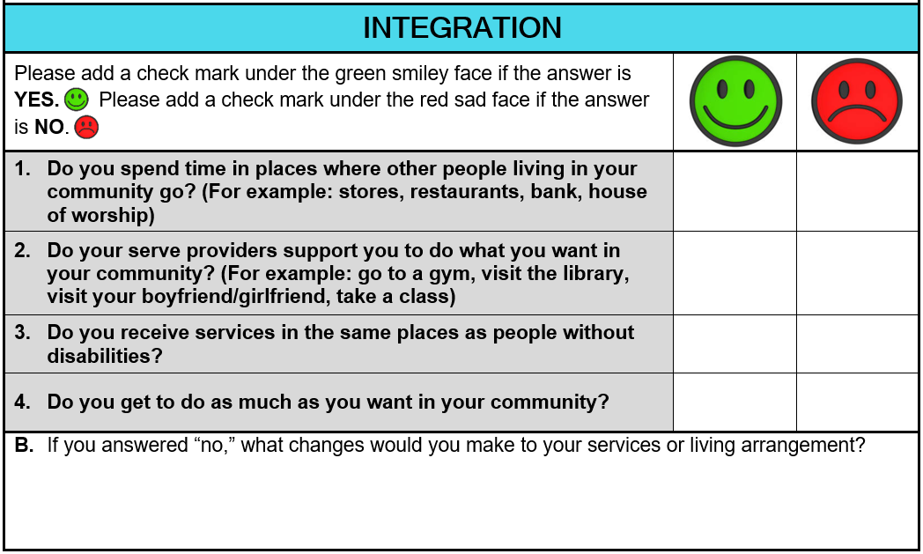
Integration and Access
Integration and access to the community means that you have the same chances to be an active and included member of your neighborhood and community as someone without disabilities.
You should have opportunities to:
• find competitive employment working alongside people without disabilities
• participate in local activities
• access services in the community just like people without disabilities

Slide 40
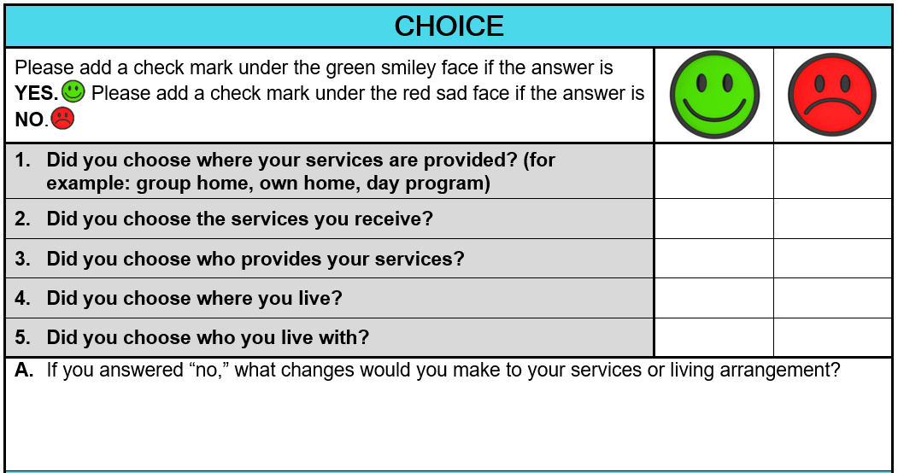
CHOICE
Choice means that you can select the services and supports that you need, as well as who provides them and where you receive them. You should have options to live and receive services in places that are for people with and without disabilities

Slide 41
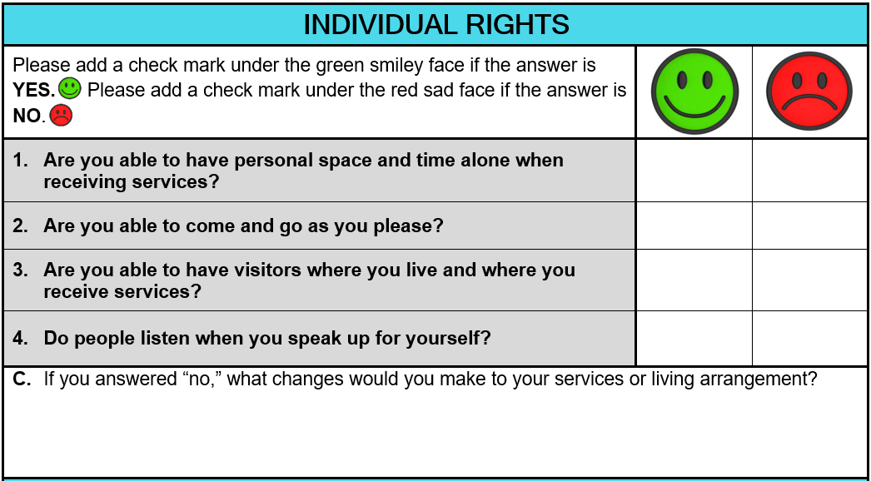
INDIVIDUAL RIGHTS
Some of the individual rights you should have are:
• being able to lock your doors
• using the phone when you want
• coming and going as you please
• having time alone when you want
Individual rights include privacy, dignity and respect, and freedom from coercion and restraint

Slide 42
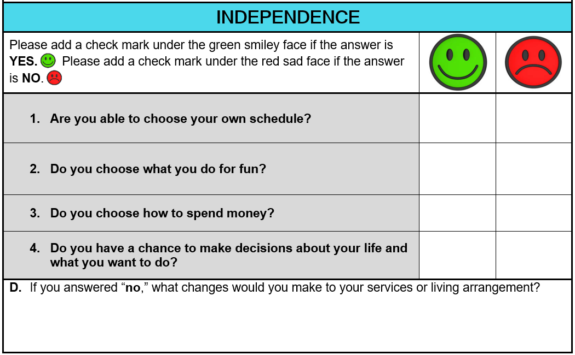
INDEPENDENCE
Some examples of independence are:
• setting your own schedule
• choosing where you want to go
• controlling your own budget
Independence means that you are in charge of making decisions about your life and what you want to do. These decisions include your daily activities, your surroundings, and the people you interact with.

Slide 43
Tell Your Story
Your stories and experiences are among the most powerful tools for change. Sharing them effectively with professionals, legislators and other advocates can make a big impact.

Slide 44
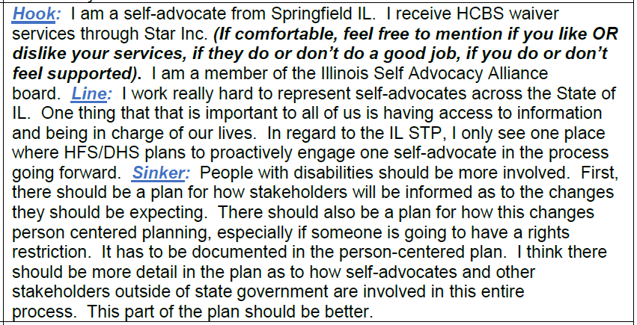
Personal Public Comment Example
Use the “Hook, Line and Sinker” Approach:
• Hook: Details about you or your family (including your disability, where you live, etc.)
• Line: Your main concern (and a specific story or fact that shows the problem)
• Sinker: What you want changed and how you want it changed

Slide 45
Policy Specific Public Comment

Slide 46
Specific Points in Current STP: Assessing Settings
Analysis: Every HCBS setting in IL will need to be compliant, therefore every HCBS setting in IL needs to be assessed as to whether they meet the standards set forth in the rule.
EXAMPLE COMMENT: We agree that all settings of 100 or more should be reviewed and that is a place to START. There should be a detailed plan as to how every setting in IL will be assessed as to their compliance with the settings rule either through review directly related to this process or through other regular review schedules as soon as possible to ensure that if a setting needs a lot of remediation there is a plan to do so that gets the setting into compliance before the 2022 deadline.
Simply Put: Review ALL settings!
According to STP:
All Community Day Service agencies serving 100 or more individuals in one building, will be assessed to ensure they meet the qualities of home and community-based settings

Slide 47
Specific Points in Current STP: Assessing Settings
According to STP 78% of HCBS Settings require no remediation to comply with new HCBS Settings rules.
Analysis: It has been 6+ years since settings were assessed and categorized. A lot can change in 6 years. We feel we are operating from a flawed foundation. We are worried that if we do not know exactly where we are today we will have a more difficult time to determine a path forward.
SAMPLE COMMENT: IL should publicize all settings categorizations so public comment can be received. There should be a detailed plan as to how every setting in IL will be assessed as to their compliance with the settings rule either through review directly related to this process or through other regular review schedules as soon as possible to ensure that if a setting needs a lot of remediation there is a plan to do so that gets the setting into compliance before the 2022 deadline. People actually receiving services and their families need to be included in AT LEAST an advisory capacity as settings are being reviewed to ensure a full picture is being provided.
Simply Put: Review every setting and include families and individuals who receive services and their families in the assessment.

Slide 48
Specific Points Current STP: Stakeholder Engagement
According to current STP there is one identified area where “one person with a developmental disability” will participate in a portion of the review process.
Consideration: This is inadequate.
Comment: The STP should include multiple access points for self-advocate and family engagement throughout this process. Stakeholder engagement should not just be limited to heightened scrutiny, but also included in policy decisions, assessments of provider settings (not just those under heightened scrutiny), and in an advisory capacity for the entire STP. It is imperative that those receiving services are informing decisions, not just those voices of those providing services.
Simply Put: Nothing about us without us at EVERY step!

Slide 49
Specific Points in Current STP: Education and Outreach
According to current STP there are will be many changes in the coming months that include new requirements for providers and new ways people will be served.
Consideration: Changes of this magnitude require robust communication strategies to ensure everyone is on the same page to the greatest extent possible.
Sample Comment: Provide ongoing consumer friendly updates in state HCBS website for stakeholders to review feedback from CMS on STP, public comments submitted by stakeholders & state’s responses as well as key milestones regularly updated until final CMS approval is received.
Simply Put: Share information and make it accessible.

Slide 50
Specific Points in Current STP: BOLD POLICY
According to current STP there are nods to consideration of technology and supported housing as options for services in Illinois
Consideration: Use of technology and expanding supportive living/housing is ESSENTIAL to expanding community services.
SAMPLE COMMENT: Illinois should follow the lead of promising practices identified by other states to expand HCBS service options for people and use the settings rule as the opportunity to make policy decisions that could include becoming a technology first state OR making supported housing/living a permanent waiver option for all service recipients.
Simply Put: Illinois needs to walk the walk!

Slide 51
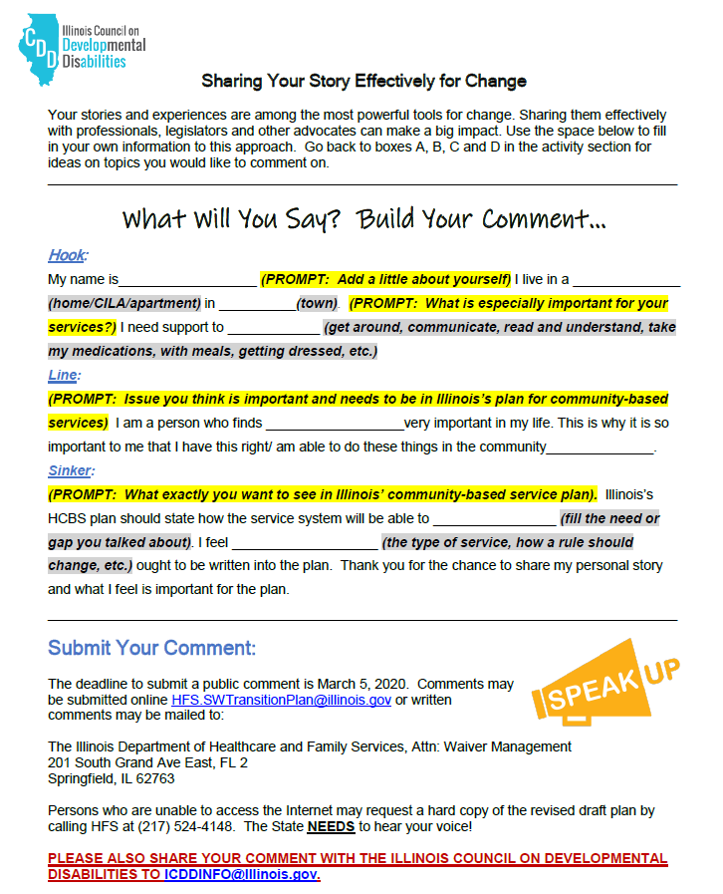
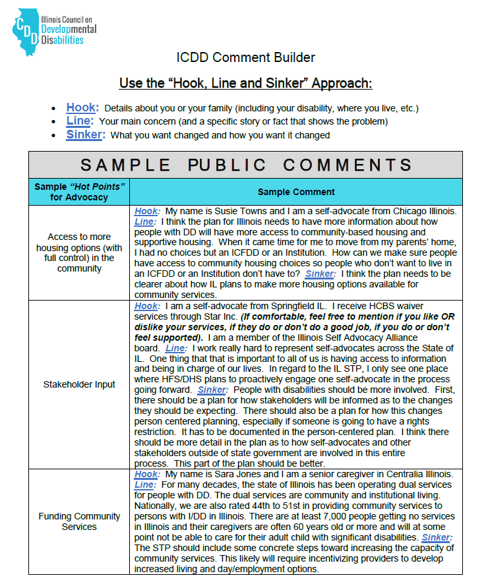
Don’t worry! Use the ICDD Public Comment Builder – Whoohoo!

Slide 52
In Summary…
Your comments can be personal about the vision you have for IL
Your comments DO NOT have to be policy specific
Your comments can be VERY policy specific
BOTTOM LINE: Your comments just need to include what YOU think the State needs to hear as they continue on the quest towards compliance with the HCBS settings rule

Slide 53
Act Now!
Let’s Review:
Limited money for community services
More than 7000 people waiting for services
HCBS settings rule can help ensure HCBS $$ is
spent services that help people live, work, learn,
Play, love in the community living
Notes:
Let’s Review:
Illinois only spends a little bit of money on home and community-based services (more than 7000 people waiting for services). We want to make sure we get bang for our buck and that the money spent is for services in the community so people can live, work, learn, play, love in the community like everyone else.

Slide 54
We Need A Robust Transition Plan
Notes:
Without a strong transition plan, this will not happen. We need to tell them:
Strengthening assessment
Has details
Increasing stakeholder involvement
Invest
Make the plan and requirements strong to stay true to the spirit of the rule – redo the tool, strengthen oversight, reporting, transparency and funding
More details
Increase stakeholder involvement at every point, not just now
Put your money where your mouth is as a state to make the settings rule a reality

Slide 55
Who? What? Where? When? Why? How?
IN PERSON:
February 27, 2020, 10am to 11:30am
Community Alternatives Unlimited
8765 W. Higgins Rd. Ste. Suite 300, Chicago, Ill. 60631
RSVP preferred, but not required, to Elizabeth at eramossosa@cau.org
March 3, 2020, 10am to 11:30am
Illinois State Capitol
501 S. Second Street, Room 122B, Springfield, IL 62756
RSVP not required

Slide 56
Speak Up and Speak Out…. In Writing
March 5 - Comments are DUE!
Submitted online HFS.SWTransitionPlan@illinois.gov
or
Written comments may be mailed to:
The Illinois Department of Healthcare and Family Services
Attn: Waiver Management
201 South Grand Ave East, FL 2 Springfield, IL 62763

Slide 57
Say It Again Sam
Comments can range from very personal and tell stories to factual and focused on public policy.
Themes can include:
Nothing about us without us
Strong assessments for everyone
Shine some sunshine on the process
Talk to us often
Put IL’s money where its mouth is!
Notes:
Key points again:
Can be from the heart, non technical – this is what community looks like to me
This what I/my family wants – this is what we don’t want
This is what my organization wants to do but can’t – here are the barriers
Themes can include:
More frequent stakeholder input – Nothing about us without us
Right assessment tools for all services/settings
Transparency – let us see and understand how Illinois is making the settings rule happen
Communications – talk to us often
Increased investment in community living to make it happen – Put IL’s money where its mouth is!

Slide 58
Next Steps and Questions
March 5 -Comments are due, Illinois will write them up, respond to them as needed and submit the plan to CMS
CMS will approve the draft and/or work with the state to address concerns
Once approved, Illinois will add to the plan and work to begin implementing it and submit a final transition plan for approval to CMS – This will require further comments from people!
March 2022 – Settings rule is required to be implemented to get federal dollars for HCBS.
Notes:
Highlight - themes:
Assessments
Make the plan and requirements strong to stay true to the spirit of the rule –
Consistent assessment,
redo the tool, strengthen oversight, reporting, transparency and funding
Strong assessments
Increase stakeholder involvement at every point, not just now
Communications transparencies -
Put your money where your mouth is as a state to make the settings rule a reality
Strengthening assessment
Providing more details
Increasing stakeholder involvement
Invest
Make the plan and requirements strong to stay true to the spirit of the rule – redo the tool, strengthen oversight, reporting, transparency and funding
More details
Increase stakeholder involvement at every point, not just now

Slide 59
HCBS Resources:
www.hcbsadvocacy.org
www.medicaid.gov/HCBS
https://www.c-q-l.org/HCBS-ACT/hcbs-act-explaining-hcbs

Slide 60
Questions?
Contact Us!
Meg Cooch, Meg@thearcofil.com
Mariel Hamer, Mariel.Hamer@illinois.gov
Nicole Jorwic, Jorwic@thearc.org
Kim Mercer-Schleider, Kimberly.Mercer-Schleider@illinois.gov
Leanne Mull or Carl Nave, leanneadvocacy@gmail.com

