Slide 1
Alive! Maryland Second Annual Needs Assessment
A Report on the Healthcare Capacity Building Needs of Maryland’s Primary Care and Infectious Disease Workforce
2022-2023
Conducted by:

Slide 2
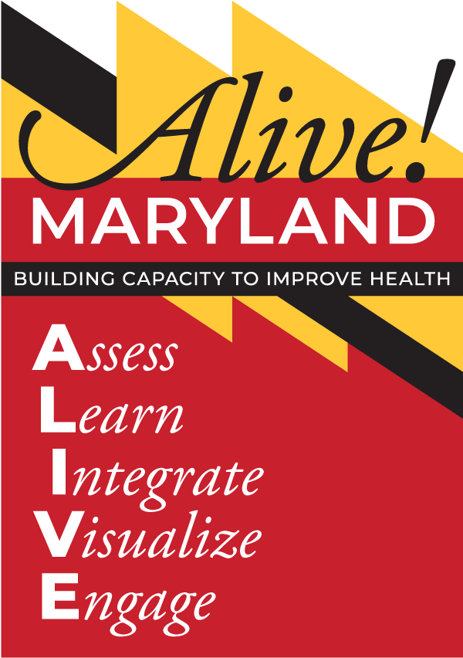
Rationale for the Alive! Maryland Program
The Maryland Department of Health has engaged with HealthHIV, a national capacity building organization, to launch Alive Maryland, the first-ever comprehensive capacity building initiative for the infectious disease and primary care workforce in the State of Maryland.
Alive! Maryland conducted its first needs assessment of the infectious disease and primary care workforce in 2021.
The second annual needs assessment’s goal is to identify new training and technical assistance needs and to assess any trends from 2021.
Notes:
In 2019, as MDH prepared a strategy for identifying the workforce development needs of healthcare personnel, more information was needed to better understand how the workforce interacts with Marylanders seeking HIV, STI, and viral hepatitis care services, including harm reduction. It is for this reason that MDH invested in Alive! Maryland; to gain more knowledge about the skills and competencies that the workforce needs to effectively do their job as well as the demographics of the workforce and their ability to liaise effectively with program participants. By integrating these data points with existing epidemiological data, MDH and its systems of care will be in an improved position to target where and how workforce development resources are deployed.
Alive! Maryland conducted its first needs assessment of the infectious disease and primary care workforce in 2021.
The 2022 Alive! Maryland Workforce Needs Assessment built upon the findings from the previous survey to identify the training needs of the infectious disease and primary care workforce as it emerged from the pandemic.

Slide 3
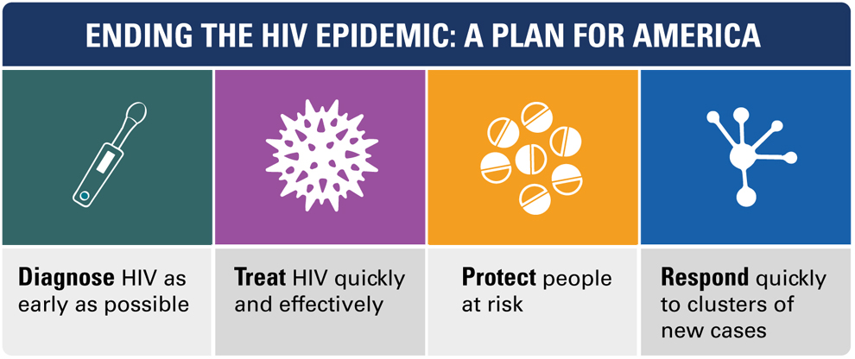
Ending the Epidemic and Maryland
In 2019, HHS launched the Ending the Epidemic (EHE) Initiative to reduce HIV by 90% by 2030 and provided funding to support the 50 U.S. jurisdictions that account for more than 50% of new HIV diagnoses.
Three jurisdictions in Maryland received EHE funding: City of Baltimore, Montgomery and Prince George’s counties.
One key focus of the EHE Initiative is to understand workforce needs, competencies, and challenges.

Slide 4
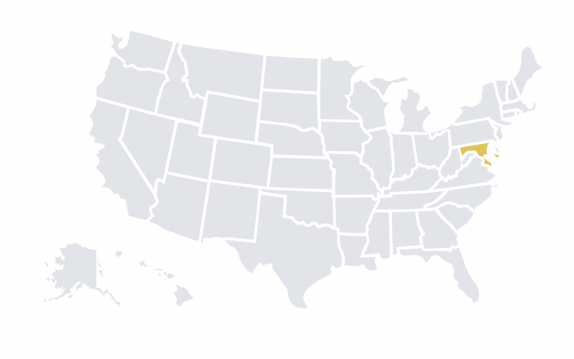
Background: Quick Maryland HIV Statistics
In 2020, Maryland ranked 12th among states and territories in adult/adolescent HIV diagnosis rates (per 100,000)
An estimated 9.2% (3,400) of PLWH in Maryland are unaware of their HIV status
With a drug-related mortality rate of 44.6 deaths per 100,000 people, Maryland ranked 6th in the country in 2020 for drug-overdose mortality
Notes:
In 2020, Maryland ranked 12th among states and territories in adult/adolescent HIV diagnosis rates (per 100,000)
An estimated 9.2% (3,400) of PLWH are unaware of their HIV status in Maryland
With a drug-related mortality rate of 44.6 deaths per 100,000 people, Maryland ranked 6th in the country in 2020 for drug-overdose mortality

Slide 5
Needs Assessment Focus Areas
Organizational background
Individual/Professional background
Client and patient engagement
Continuity of program services and service utilization
Workforce burnout and retention
Community Health Workers
Technical assistance needs
Notes:
This year’s survey was developed using lessons learned from training evaluations as well as the findings from the 2021 Alive! Maryland Assessment, which reflected high levels of pandemic-related burnout and a need for more coordinated medical and community-based services.
This year, Alive! Maryland sought to further quantify and qualify the infectious disease and primary care workforce by asking survey questions relating to the following topics:
Organizational background
Individual/Professional background
Client and patient engagement
Continuity of program services and service utilization
Workforce burnout and retention
Community Health Workers
Technical assistance needs

Slide 6
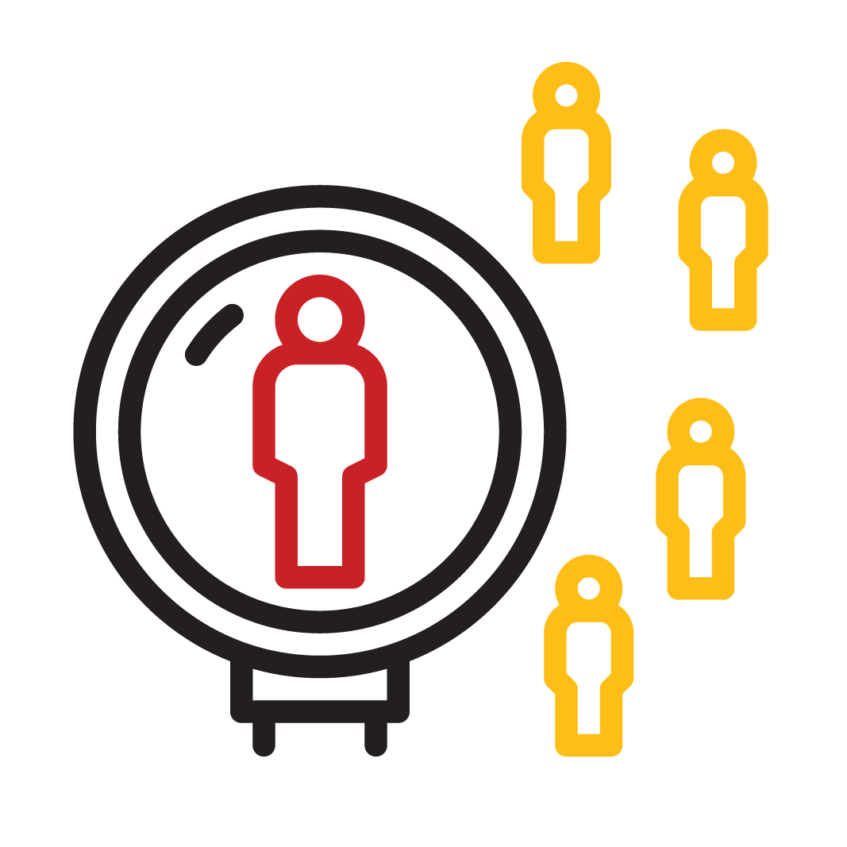
Survey Overview and Methods
Method: Online survey administered via REDCap.
Inclusion Criteria: Includes those who work in infectious disease and primary care fields such as health care providers, behavioral health providers, executive staff, medical staff, administrators, etc.
Timeframe: October 26th to December 21st, 2022
Number of Participants: 306
Notes:
This needs assessment was conducted from October to December of 2022, utilizing an online survey hosted on Research Electronic Data Capture (REDCap), a secure web application for building and managing online surveys and databases.
HealthHIV, in collaboration with MDH, conducted outreach using a sampling approach that ensures representation from across the state.
Eligible participants were defined as adult clinical and non-clinical health care providers who work in the field of infectious disease and/or primary care in the state of Maryland.
The survey closed in late December with 306 responses.

Slide 7
What is the current state of infectious disease and primary care in Maryland?
Notes:
To begin the needs assessment, respondents were asked to describe the current state of infectious and primary care in Maryland in one word. Respondents answered along a continuum from lacking to promising, signifying that providers are reporting a vast range of experiences.

Slide 8
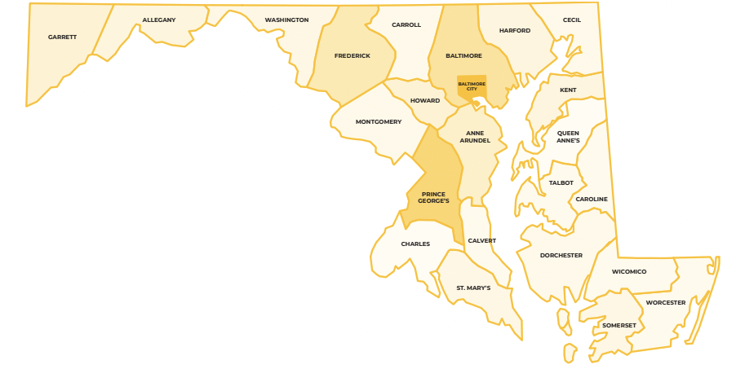
Participant Demographics: Location
Included respondents from all 24 jurisdictions in MD, but primarily from:
Baltimore City (22%)
Prince George’s County (13%)
Baltimore County (9%)
18% of respondents work for organizations located in rural areas of the state.
Notes:
The survey included respondents from all 24 jurisdictions in Maryland, primarily from Baltimore City (22%), Prince George’s County (13%) and Baltimore County (9%). 18% of respondents work for organizations located in rural areas of the state.

Slide 9
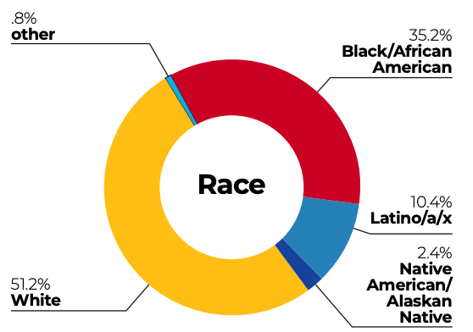
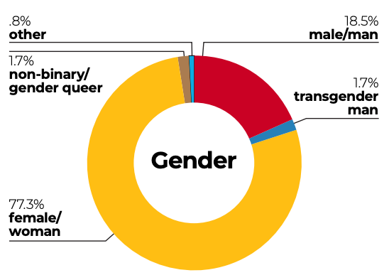
Participant Demographics: Race & Gender
Race: 51% identified as White, and 35% as Black/African American
Gender: 77% identified as woman/female, 19% man/male, and 4% as trans or gender queer/gender non‐binary
Notes:
Almost half of respondents were 45 to 64 years old (49%). Out of the 306 total respondents, 53% identified as White and 38% identified as Black/African-American; 11% identified as Hispanic or Latino/a/x. More than three-fourths identified as woman/female.

Slide 10
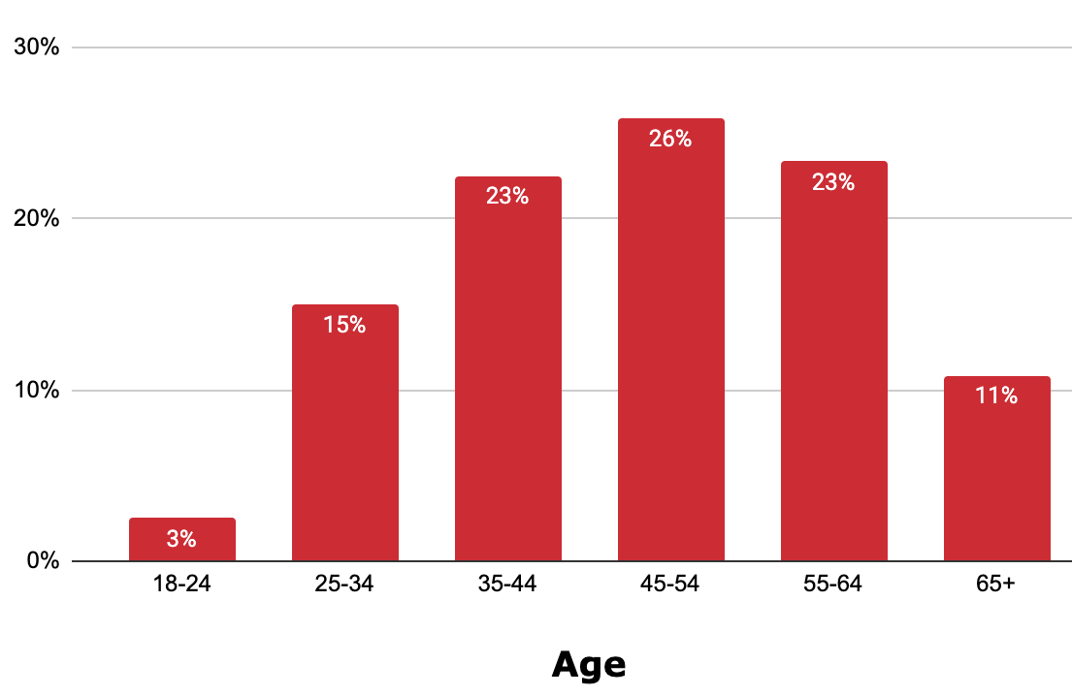
Participant Demographics
Professional Background: Majority social workers, CHWs, and nurses. Almost half work at health departments and 18% work for CBOs.
Age: More than half of respondents were 45 to 64 years of age
Notes:
Respondents included clinical and administrative staff, with approximately 45% of all respondents identifying as social workers, community health workers (CHWs), or other behavioral health coordinators; 40% identifying as nurses (NPs, RNs, APRNs); and just under 10% as physicians (MDs, DOs). Among clinical providers, 33% report specializing in substance use disorder treatment, 22% in infectious disease health services, and 15% in mental health services. Of the total number of respondents, 13% report being licensed to prescribe medication.

Slide 11
Top 5 Services Offered by Respondents:
Notes:
Respondents indicated that they offered a wide
range of clinical services. The most common
services reported were as follows:
◥ 70% provide HIV testing
◥ 62% provide STI testing
◥ 56% provide STI treatment
◥ 53% provide mental health services
◥ 47% provide substance use diagnosis/treatment
◥ 48% provide HCV screening
◥ 21% provide primary care

Slide 12
Training Categories
Respondents were asked to identify training needs across six content areas including:
Notes:
Respondents were asked to identify training needs across six content areas including workplace culture, caring for priority populations, prevention, clinical care and treatment, behavioral health care and treatment, and organizational and infrastructure development.

Slide 13
Training Needs: General
The top five training topics requested by respondents across all six areas were:
Mental Health
Retention and Re-engagement in Care
Substance Use among people living with HCV, STIs, and/or HIV
Whole Person Health
Stigma and Cultural Humility/Cultural Flexibility
Notes:
These selections suggest that respondents are focused on strengthening wrap-around services and supporting patient mental health in the face of the ongoing behavioral health epidemic and converging public health crises, namely COVID-19 and MPox. The results also demonstrate that respondents desire to integrate care along the HIV continuum in order to ensure comprehensive linkage to services and long-term patient retention.
Additionally, the high percentage of respondents who indicated needing increased clinical training on substance use among people living with HCV, STIs, and HIV, points towards the difficult reality of substance use in Maryland. As a response, CBA efforts through the Alive! Maryland initiative should prioritize behavioral healthcare, including SUD screening, diagnosis, counseling and treatment.

Slide 14
Training Needs: Trends from 2021
When compared with training priorities from the 2021 needs assessment, this year’s responses indicate continued focus on mental health and substance use.
Training Needs: 2021
Mental Health
Harm Reduction
Substance Use among people living with HCV, STIs, and/or HIV
Community Health Center/PCP Engagement
Social Media and Marketing
Training Needs: 2022
Mental Health
Retention in Care
Substance Use among people living with HCV, STIs, and/or HIV
Whole Person Health
Stigma and Cultural Humility/Cultural Flexibility

Slide 15
Training Needs: CHWs
Retention and Re-engagement in Care
Behavioral Surveillance
Testing (Routine, Streamline, Rapid, Clinical/Non-Clinical Settings)
High-Impact HIV Prevention
Data to Care Surveillance/Care Provision (Use of multiple treatment/care data sources to identify persons who are not in care)
Community Health Center/Primary Care Provider Engagement
CHWs most frequently requested training within the area of Prevention and Surveillance:
Notes:
This year’s Needs Assessment included a special focus on Community Health Workers (CHWs). About a quarter of respondents identified as CHWs and 70% indicated that their organization employs CHWs.
Respondents were nearly evenly split when asked whether they feel like the CHW workforce in Maryland is well supported, with 21% saying CHWs are well supported and 23% saying they are not. The remaining 56% felt “unsure.”
CHWs had the highest response rate for requesting technical/training assistance within the topic of Prevention and Surveillance – very high percentages for wanting the following trainings: [read list from slide]

Slide 16
CHWs Seek Integration and Standardization
Primary roles of CHWs:
Addressing the needs of diverse populations in a culturally sensitive way (71%)
Communicating ideas and information in a way that clients and patients can understand (66%)
Collaborating with diverse communities to identify and solve health problems (60%)
Do respondents require their CHWs to be certified by an MDH-accredited training?
Notes:
Maryland is one of the only states in the country that requires that all CHW certification training programs be accredited by the Department of Health, representing statewide interest in standardizing and scaling up implementation of CHW programs.
The Needs Assessment included several questions evaluating the workforce’s perception of CHWs and extent to which standardization and implementation have succeeded on the ground.
Over a third of respondents require their CHWs to be certified by one of the MDH-accredited trainings. However, 30% of respondents do not require CHW certification, reflecting inconsistent expectations for CHW preparation. When asked to identify
The primary roles of CHWs in their organization, respondents most frequently selected: ◥ Addressing the needs of diverse populations in a culturally sensitive way (71%)
◥ Communicating ideas and information in a way that patients and patients can understand (66%
◥ Collaborating with diverse communities to identify and solve health problems (60%)

Slide 17
CHWs Seek Integration and Standardization
When asked whether they agree that CHWs are fully integrated throughout their organization, respondents answered along a broad continuum:
◥ Totally agree (24%) ◥ Somewhat agree (33%) ◥ Neutral (22%) ◥ Somewhat disagree (16%) ◥ Totally disagree (6%)
Notes:
When asked whether they agree that CHWs are fully integrated throughout their organization, respondents answered along a broad continuum, with the majority agreeing, to some extent, that CHWs are fully integrated:
◥ Totally agree (24%)
◥ Somewhat agree (33%)
◥ Neutral (22%)
◥ Somewhat disagree (16%)
◥ Totally disagree (6%)
Additionally, nearly 40% of respondents agreed that other departments/teams in their organization could integrate CHWs but are unaware of how to do so, indicating significant room for improvement regarding the full optimization of CHWs in organizations.
CHWs need standardized industry roles and fair compensation that reflects the difficulty and importance of their position. Crucially, the majority of respondents also reported seeing a need to hire/ work with more CHWs in the future

Slide 18
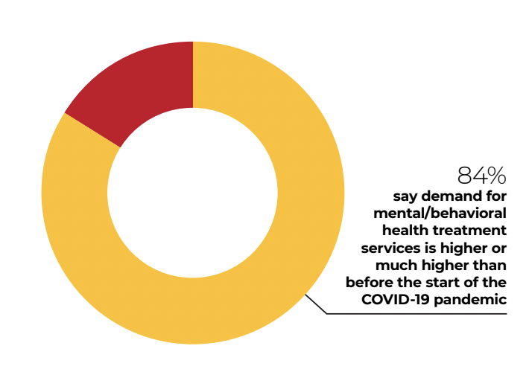
Mental Health and SUD Concerns Grow
The demand for mental/behavioral health treatment services in 2022 is significant.
40% of respondents reported that Substance Use among people living with HCV, STIs, and HIV is their greatest clinical training need
Greatest challenges to providing mental health services are:
Lack of mental/behavioral health care providers and support staff
Stigma surrounding mental illness
Difficulty reaching vulnerable populations
Notes:
Respondents consistently expressed concern for the state of patient mental health and well-being in the wake of COVID-19. An overwhelming majority of respondents (84%) report that the demand for mental/behavioral health treatment services in 2022 is higher or much higher than before the start of the COVID-19 pandemic.
This finding reflects the significant mental health burden facing Marylanders, and in particular, low-income and/or minority residents navigating multiple barriers to care. In February 2021, nearly 40% of adults in Maryland reported symptoms of anxiety or depression, nearly a third of whom were unable to get needed counseling or therapy for a variety of reasons including cost and provider shortages.
Mental health care is ten times more likely to be out-of-network for Marylanders than primary health care, and over 1 million state residents live in communities without enough mental health professionals
Needs Assessment respondents echoed these points, noting that the greatest challenges to providing mental health services are:
◥ Lack of mental/behavioral health care providers and support staff (64%)
◥ Stigma surrounding mental illness (50%)
◥ Difficulty reaching vulnerable populations (37%)
In fact, 40% of respondents reported that Substance Use among people living with HCV, STIs, and HIV is their greatest clinical training need
In a year of a worsening syndemic and continued upheaval in healthcare, comprehensive behavioral health services are needed more than ever.

Slide 19
Workforce Burnout Persists
How often does the workforce feel emotionally drained from work?
Half of respondents said they have considered quitting their job at some point in the last 6 months.
Notes:
Recent workforce studies show that healthcare workers in the United States are currently experiencing unprecedented levels of burnout and exhaustion.
The 2022 Needs Assessment echoed these reports, confirming that the experiences of Maryland’s healthcare workforce reflect national trends. When asked how often they feel emotionally drained from work, 22% of respondents said a few times a month, 22% said a few times a week, and 16% said every day. Even more significantly, when asked whether they have considered quitting their job at any point in the past six months, half of respondents said ‘yes’.

Slide 20
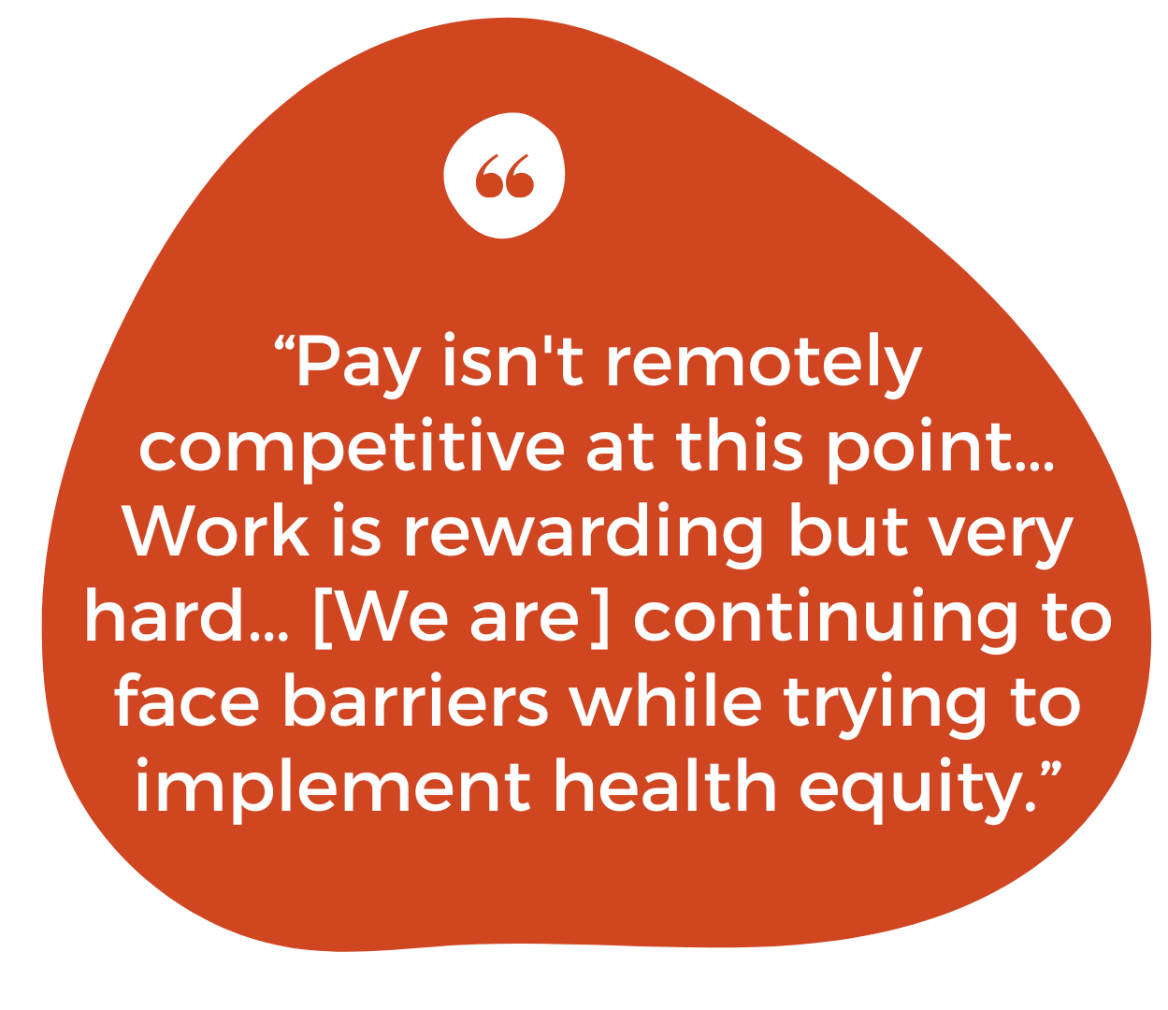
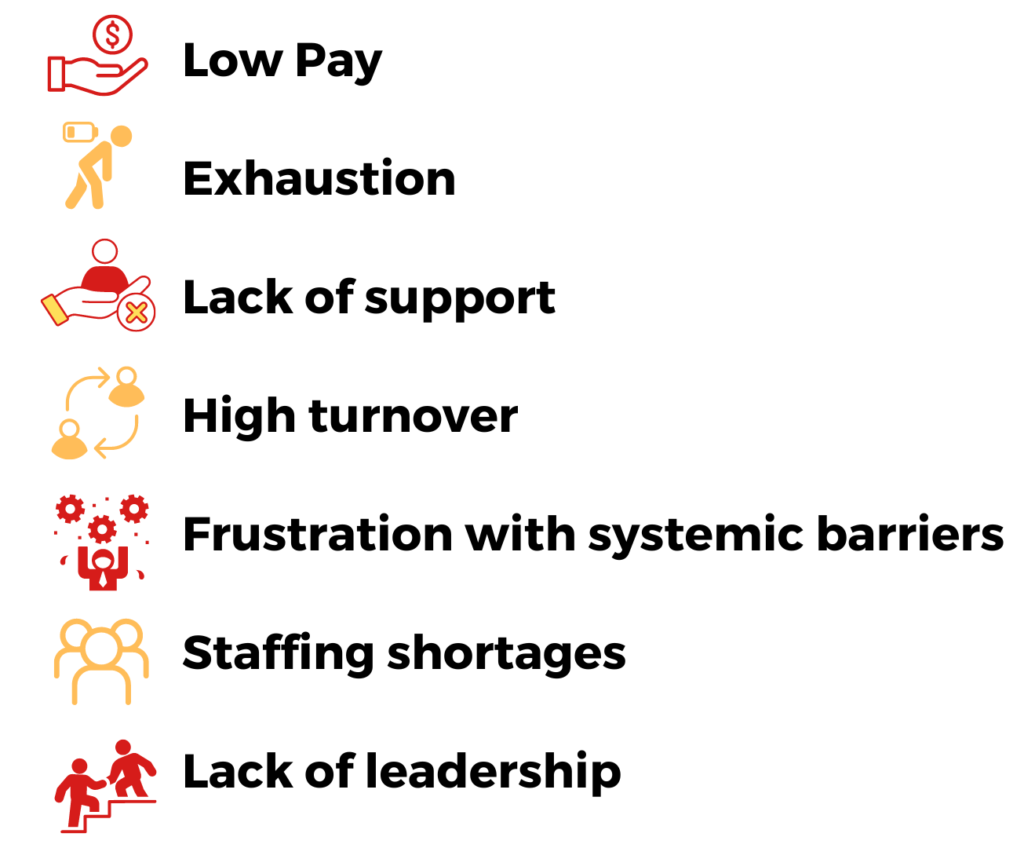
Workforce Burnout Persists
Respondents provided a variety of explanations for why they have considered quitting their jobs including:
Notes:
Respondents provided a variety of explanations for why they have considered quitting their jobs that reinforce this point, including:
◥ Low Pay
◥ Exhaustion
◥ Being overworked
◥ Lack of support
◥ High turnover
◥ Frustration with systemic barriers
◥ Staffing shortages
◥ Lack of leadership
One respondent explained:
“Pay isn’t remotely competitive at this point... Work is rewarding but very hard... [We are] continuing to face barriers while trying to implement health equity.”
The findings point to a clear need for urgently developing retention strategies for Maryland’s infectious disease and primary care providers. Respondents indicated that the most successful methods for addressing staff burnout include allowing flexible hours, offering mental health/ wellness focused days, and hiring more support staff to align skill-to-task.

Slide 21
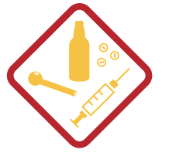
Implications
Growing need to widely implement mental health services
Providers need support from regional leaders and local health departments in developing workflows for integrating behavioral health assessments and counseling into regular services.
There is also considerable need for more behavioral health providers at all levels of care
Importance of integrating substance use care
Most providers, regardless of type and setting, are encountering challenges relating to substance use.
SUD assessments and care referrals must be integrated into standard healthcare services.
Notes:
As we reach the end of a third year marked by escalating and converging epidemics, broad-scale disruptions to social support systems and care services continue to mount nationwide. Maryland providers echo this national reality, listing mental health concerns as one of the greatest challenges facing their patients in 2022. The importance of comprehensive wrap-around services and point-of-care referral pipelines is clearer than it has been in recent years. Behavioral health assessments should be included as standard parts of regular clinic and primary care visits. Providers need support from regional leaders and local health departments in developing workflows for integrating behavioral health assessments and counseling into regular services. Normalizing mental health care as part of standard health visits will also work to combat stigma, which respondents listed as a significant barrier to care. There is also considerable need for more behavioral health providers at all levels of care, from hospitals, clinics, and primary healthcare settings, health departments, and substance-use treatment facilities. Addressing staff shortages will offer relief to current behavioral health providers experiencing compassion fatigue and burnout.
Additionally, substance use among people living with HCV, STIs, and/or HIV was identified by respondents as one of topics for which Maryland’s healthcare workforce requires the most training. It was also listed as the number one training need relating to
clinical care and treatment. This is true despite the fact that only 6% of respondents work at substance- use treatment facilities, demonstrating that most providers, regardless of type and setting, are encountering challenges relating to substance use. This is also reflective of Maryland’s high drug-related mortality rate (44.6 deaths/100,000 people in 2020) and widespread mental health challenges in the wake of COVID-19. Like mental health care, SUD assessments and care referrals must be integrated into standard healthcare services.

Slide 22
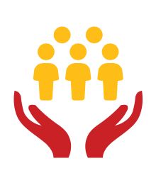
Implications
Investing in staff retention should be a priority
Providers are tired and overworked and leaving the workforce at unprecedented rates.
COVID-19 may have been the tipping point, but participant responses indicate the existence of deeper, long-brewing issues relating to compensation, compassion fatigue, lack of operational support, and accumulating frustration with systemic barriers.
Providers in rural areas need additional support
Workforce shortages are a leading cause of burnout among rural respondents.
Though rural providers overwhelmingly feel that their work is worthwhile, they have considered quitting their job in the last six months more often than their urban/suburban counterparts (55% and 49%, respectively).
Notes:
The findings of this needs assessment demonstrate that burnout and work-related anxiety and fatigue are some of the greatest challenges currently facing Maryland’s healthcare workforce. It is crucial that organizations and program leaders invest in employee retention. Respondents noted that flexibility and employee autonomy are key to preventing burnout. Additionally, respondents described the importance of employee wellness programs that prioritize helping employees access mental health services and support opportunities for professional development and advancement. In order for their work to be sustainable, healthcare workers say, their employers need to consider their welfare and offer material assistance in the form of training and pay.
Finally, The needs of rural providers are often distinct from those of their urban and suburban counterparts. This is critical to keep in mind when addressing the needs of Maryland’s healthcare workforce, as 75% of the state’s jurisdictions are rural. Like urban/suburban respondents, rural respondents frequently requested training content in areas, such as patient retention, substance use care, and best screening practices. However, rural respondents were more likely to request training in primary care provider engagement, data-to-care surveillance, and service integration. These needs may reflect increased healthcare shortages in rural areas. In fact, workforce shortages are a leading cause of burnout among rural respondents. A significant majority (65%) of rural healthcare workers in Maryland report a lack of behavioral health providers, compared to 55% of urban and suburban workers. Though rural providers overwhelmingly feel that their work is worthwhile, they have considered quitting their job in the last six months more often than their urban/suburban counterparts (55% and 49%, respectively).

Slide 23
Conclusion:
Integration and Access for a Healthier Maryland
Notes:
The final question in the assessment asked participants to describe their vision for infectious disease and primary care provision in Maryland, in one word. Participant responses reflect the themes drawn from all the previous data outlined in this report. Some of the most common words submitted by respondents include those shown in this word cloud.

Slide 24
Thank you!
info@alivemaryland.org

